Slide 1
CUDA 4 Prefix Sums
CS121 Parallel Computing
Spring 2020

Slide 2
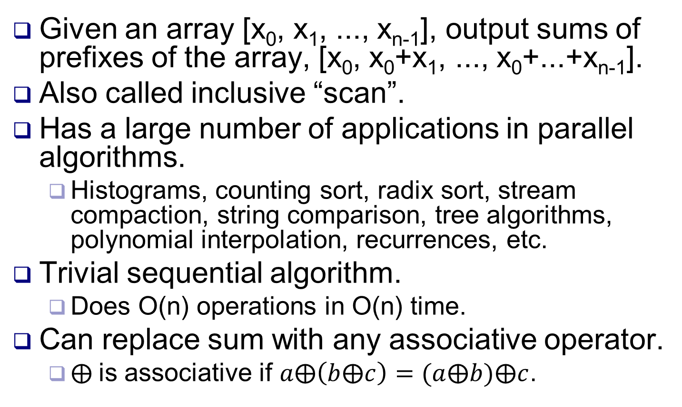
Prefix sum
Given an array [x₀, x₁, ..., x_{n-1}], output sums of prefixes of the array, [x₀, x₀+x₁, ..., x₀+...+x_{n-1}].
Also called inclusive “scan”.
Has a large number of applications in parallel algorithms.
Histograms, counting sort, radix sort, stream compaction, string comparison, tree algorithms, polynomial interpolation, recurrences, etc.
Trivial sequential algorithm.
Does O(n) operations in O(n) time.
Can replace sum with any associative operator.
$⨁$is associative if $a⨁\left(b⨁c\right)=(a⨁b)⨁c$.

Slide 3
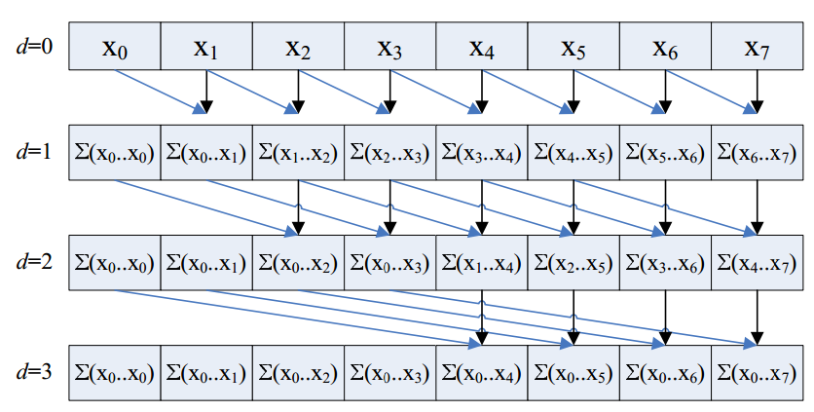
Parallel prefix sum (naive)
for (i = 1; i < log(n); i++)
for all tid in parallel
if (tid >= 2^{i})
sum[out][tid] = sum[in][tid-2^{i-1}] + x[in][tid]
else
sum[out][tid] = sum[in][tid]
swap in, out
Parallel Prefix Sum (Scan) with CUDA, Mark Harris
Map one thread to each element.
log₂ n iterations (assume n is power of 2).
Set stride to 1, 2, 4, ..., n.
Threads > stride add value from stride below to itself.
Two output buffers sum[in], sum[out]. Initially in=0, out =1. Swap after each iteration.
Single buffer would have race condition (how?).

Slide 4
Work analysis
for (i = 1; i < log(n); i++)
for all tid in parallel
if (tid >= 2^{i})
sum[out][tid] = sum[in][tid-2^{i-1}] + x[in][tid]
else
sum[out][tid] = sum[in][tid]
swap in, out
Parallel Prefix Sum (Scan) with CUDA, Mark Harris
Number of operations in iteration i is n – stride(i).
Total number of operations is (n-1) + (n–2) + (n–4) + ... + (n–n/2) = O(n log n).
Sequential (and optimal) complexity is O(n).
Extra O(log n) factor complexity really matters in practice.
20 times slower for n = 1M!

Slide 5
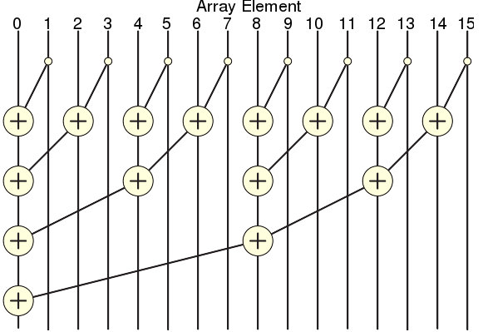
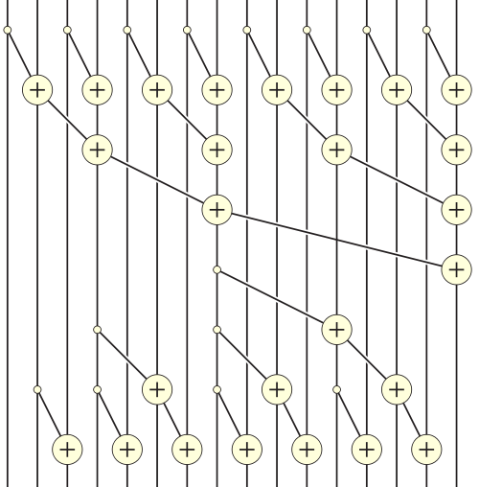
Efficient parallel prefix sum
Want algorithm to do O(n) work.
Recall the parallel reduction algorithm, which does O(n) work.
Efficient algorithm does a reduction, followed by the reduction “in reverse”.
Call these the up-sweep and down-sweep phases, resp.
Prefix sum (Brent-Kung)

Slide 6
Efficient parallel prefix sum

Slide 7
Efficient parallel prefix sum
int stride = 1;
while (stride <= blockDim.x) {
int i = 2*stride*(threadIdx.x+1)-1;
if (i < 2*blockDim.x)
sum[i] += sum[i-stride];
stride *= 2;
__syncthreads();
}
int stride = blockDim.x/2;
while (stride > 0) {
int i = 2*stride*(threadIdx.x+1)-1;
if (i+stride < 2*dimBlock.x)
sum[i+stride] += sum[i];
stride /= 2;
__syncthreads();
}
A thread block computes prefix sum of array sum in shared memory.
Size of sum is 2*(block size).
In example, block size = 8.
In down sweep, threads 0 to (block size) / stride – 1 work in iteration stride.
In up sweep, threads 0 to (block size) / (2*stride) – 1 work in iteration stride .

Slide 8
Exclusive scans
Just like a normal scan, except each input value shouldn’t include itself in its output.
Ex [1,2,3,4] ⇒ [0,1,3,6].
Up-sweep is the same as in inclusive scan.
But during down-sweep, first zero out the final output value.
Then follow a half butterfly pattern downwards.
Each right child sums its parents’ values.
Each left child takes its parent’s value.

Slide 9
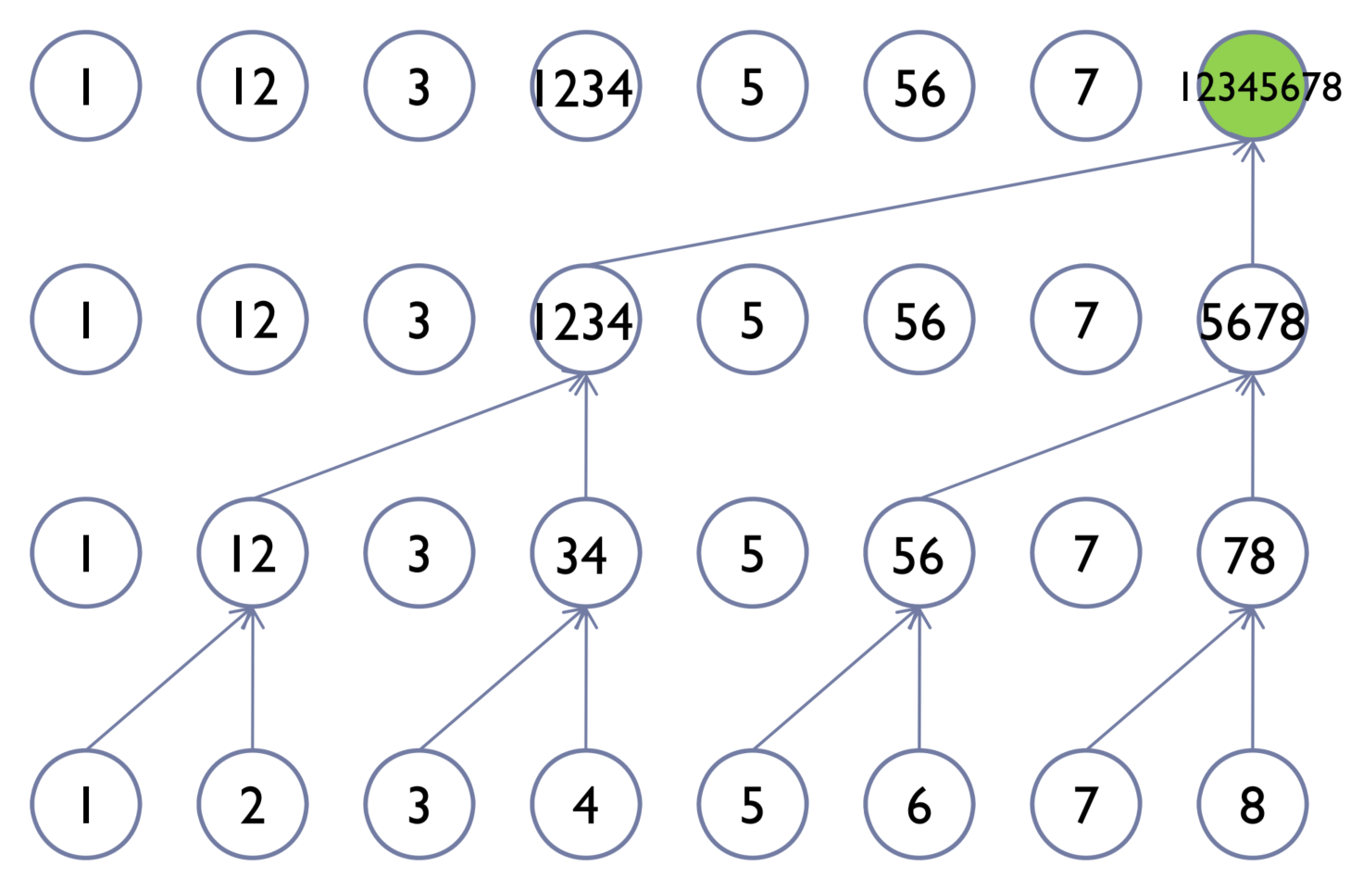
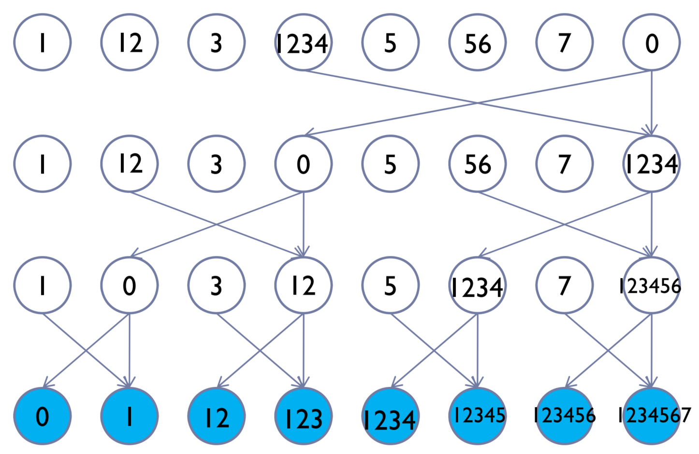
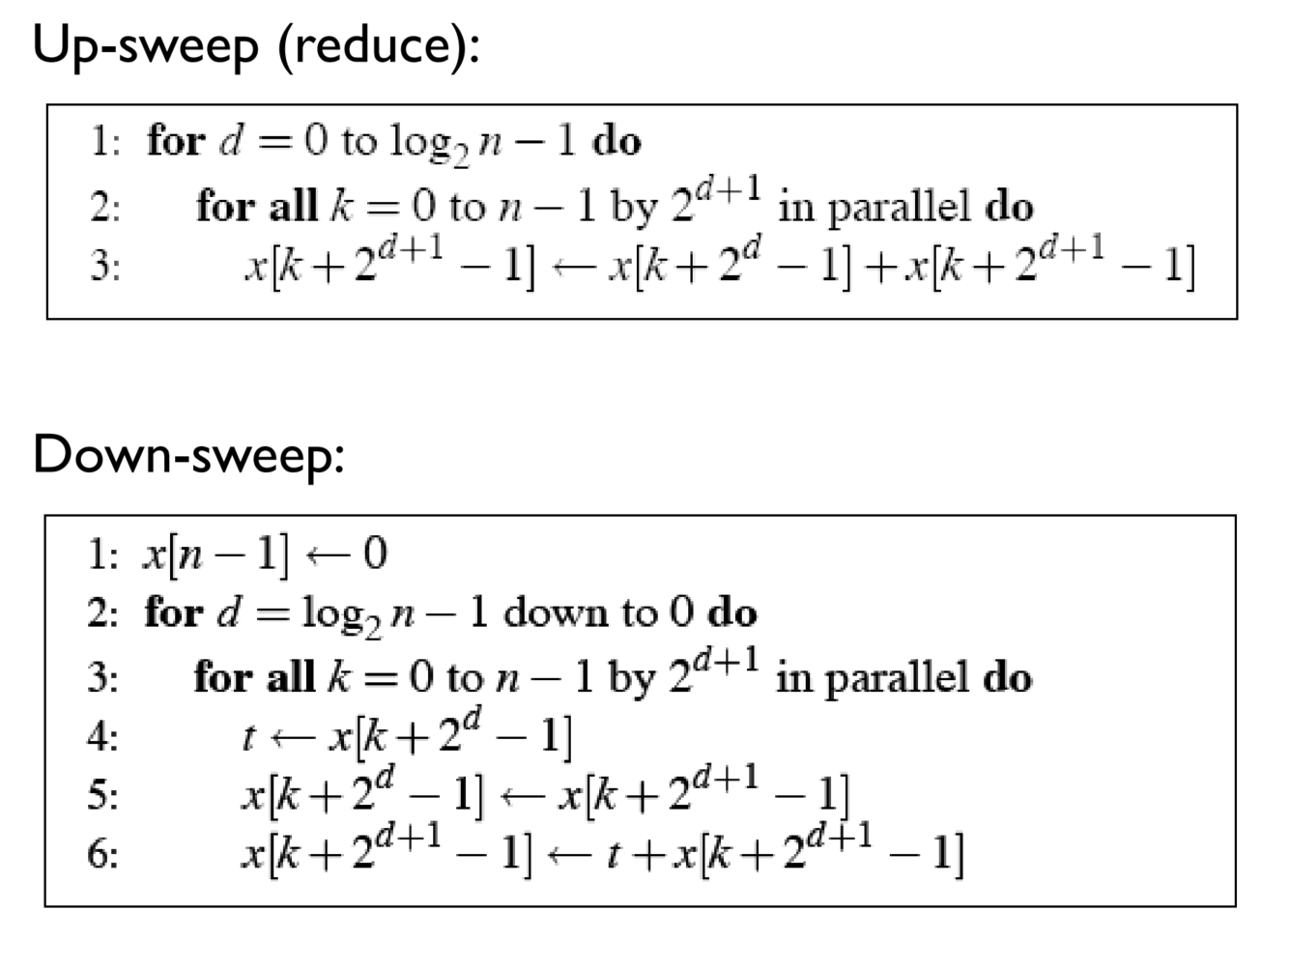
Exclusive scans
Up-sweep
Down-sweep
Source: http://courses.me.berkeley.edu/ ME290R/S2009/lectures/lec15.PDF

Slide 10
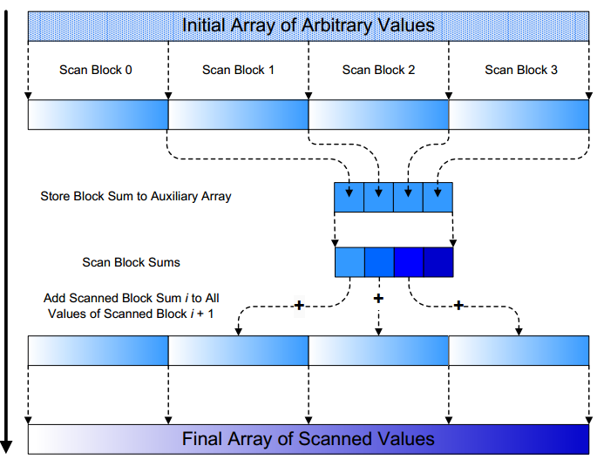
Arbitrary input size
The inclusive scan algorithm only works for array size ≤ 2*(block size).
For bigger inputs, break it into segments of size 2*(block size).
Compute prefix sum on each segment using block algorithm.
Copy sum of whole segment (stored in sum[blockDim.x-1]) to segment_sum array.
Do this for all blocks until they all finish.
Ensure blocks finished by ending kernel.
Compute prefix sum of segment_sum array in a second kernel.
In a third kernel, distribute prefix sums to each segment.
Segment increases all values by prefix sum received.

Slide 11
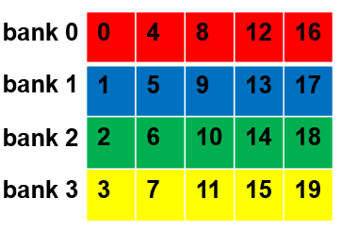
Bank conflicts
Recall memory address x stored at x % n if shared memory has n banks.
Current GPUs have 32 banks.
Current algorithm has many bank conflicts, causing serialized accesses.
16 banks, stride = 1. 2 way bank conflicts
tid
0 | 1 | 2 | 3 | 4 | 5 | 6 | 7 | 8 | 9 | 10 | 11 | 12 | 13 | 14 | 15
1 | 3 | 5 | 7 | 9 | 11 | 13 | 15 | 17 | 19 | 21 | 23 | 25 | 27 | 29 | 31
1 | 3 | 5 | 7 | 9 | 11 | 13 | 15 | 1 | 3 | 5 | 7 | 9 | 11 | 13 | 15
...
int i = 2*stride* (threadIdx.x+1)-1;
if (i < 2*blockDim.x)
sum[i] += sum[i-stride];
...
i
bank
16 banks, stride = 2. 4 way bank conflicts
tid
0 | 1 | 2 | 3 | 4 | 5 | 6 | 7 | 8 | 9 | 10 | 11 | 12 | 13 | 14 | 15
3 | 7 | 11 | 15 | 19 | 23 | 27 | 31 | 35 | 39 | 43 | 47 | 51 | 55 | 59 | 63
3 | 7 | 11 | 15 | 3 | 7 | 11 | 15 | 3 | 7 | 11 | 15 | 3 | 7 | 11 | 15
i
bank

Slide 12
Removing bank conflicts
Remove bank conflicts by padding the sum array.
Store i’th item at address i + floor(i / (# banks)) instead of address i.
Do this for reads and writes.
Waste some space (~3% with 32 banks), but get faster performance.
Ex 4 banks.
Padding is a general strategy for removing bank conflicts, though exact scheme depends on problem.
array
0 | 1 | 2 | 3 | 4 | 5 | 6 | 7 | 8 | 9 | 10 | 11
padded array
0 | 1 | 2 | 3 | P | 4 | 5 | 6 | 7 | P | 8 | 9 | 10 | 11

Slide 13
Removing bank conflicts
16 banks, stride = 2. 4 way bank conflicts
tid
0 | 1 | 2 | 3 | 4 | 5 | 6 | 7 | 8 | 9 | 10 | 11 | 12 | 13 | 14 | 15
3 | 7 | 11 | 15 | 19 | 23 | 27 | 31 | 35 | 39 | 43 | 47 | 51 | 55 | 59 | 63
3 | 7 | 11 | 15 | 3 | 7 | 11 | 15 | 3 | 7 | 11 | 15 | 3 | 7 | 11 | 15
i
bank
16 banks, stride = 2, i’ = i + floor(i / # banks). No bank conflicts
tid
0 | 1 | 2 | 3 | 4 | 5 | 6 | 7 | 8 | 9 | 10 | 11 | 12 | 13 | 14 | 15
3 | 7 | 11 | 15 | 20 | 24 | 28 | 32 | 37 | 41 | 45 | 49 | 54 | 58 | 62 | 66
3 | 7 | 11 | 15 | 4 | 8 | 12 | 0 | 5 | 9 | 13 | 1 | 6 | 10 | 14 | 2
i’
bank

Slide 14
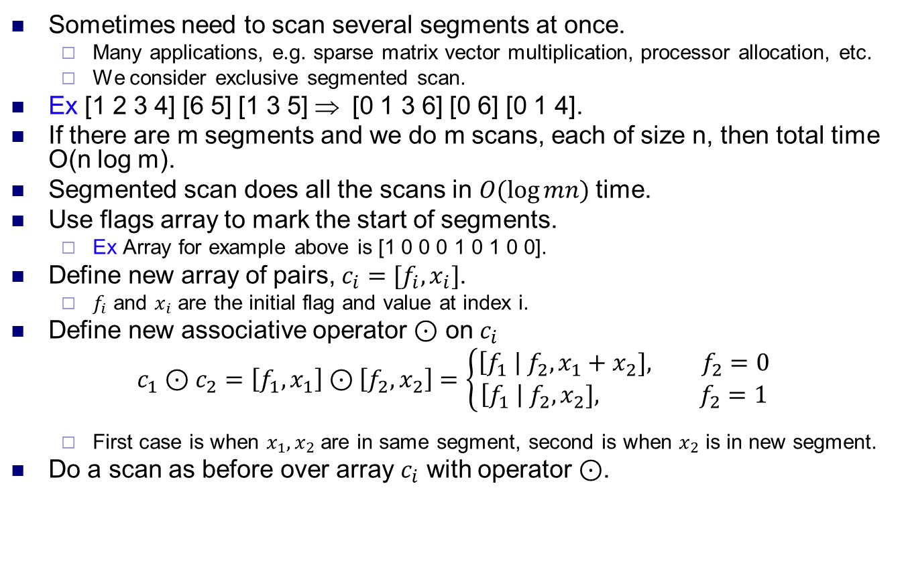
Segmented scan
Sometimes need to scan several segments at once.
Many applications, e.g. sparse matrix vector multiplication, processor allocation, etc.
We consider exclusive segmented scan.
Ex [1 2 3 4] [6 5] [1 3 5] ⇒ [0 1 3 6] [0 6] [0 1 4].
If there are m segments and we do m scans, each of size n, then total time O(n log m).
Segmented scan does all the scans in $O(log⁡mn)$time.
Use flags array to mark the start of segments.
Ex Array for example above is [1 0 0 0 1 0 1 0 0].
Define new array of pairs, $c_{i}=[f_{i}, x_{i}]$.
$f_{i}$ and $x_{i}$ are the initial flag and value at index i.
Define new associative operator $⊙$ on $c_{i}$
$$c_{1}⊙c_{2}=\left[f_{1},x_{1}\right]⊙\left[f_{2},x_{2}\right]=\left\{\begin{aligned}\left[f_{1} \right| f_{2}, x_{1}+x_{2}], f_{2}=0 \\ &\left[f_{1} \right| f_{2}, x_{2}], f_{2}=1\end{aligned}\right.$$
First case is when $x_{1},x_{2}$ are in same segment, second is when $x_{2}$ is in new segment.
Do a scan as before over array $c_{i}$ with operator $⊙$.

Slide 15
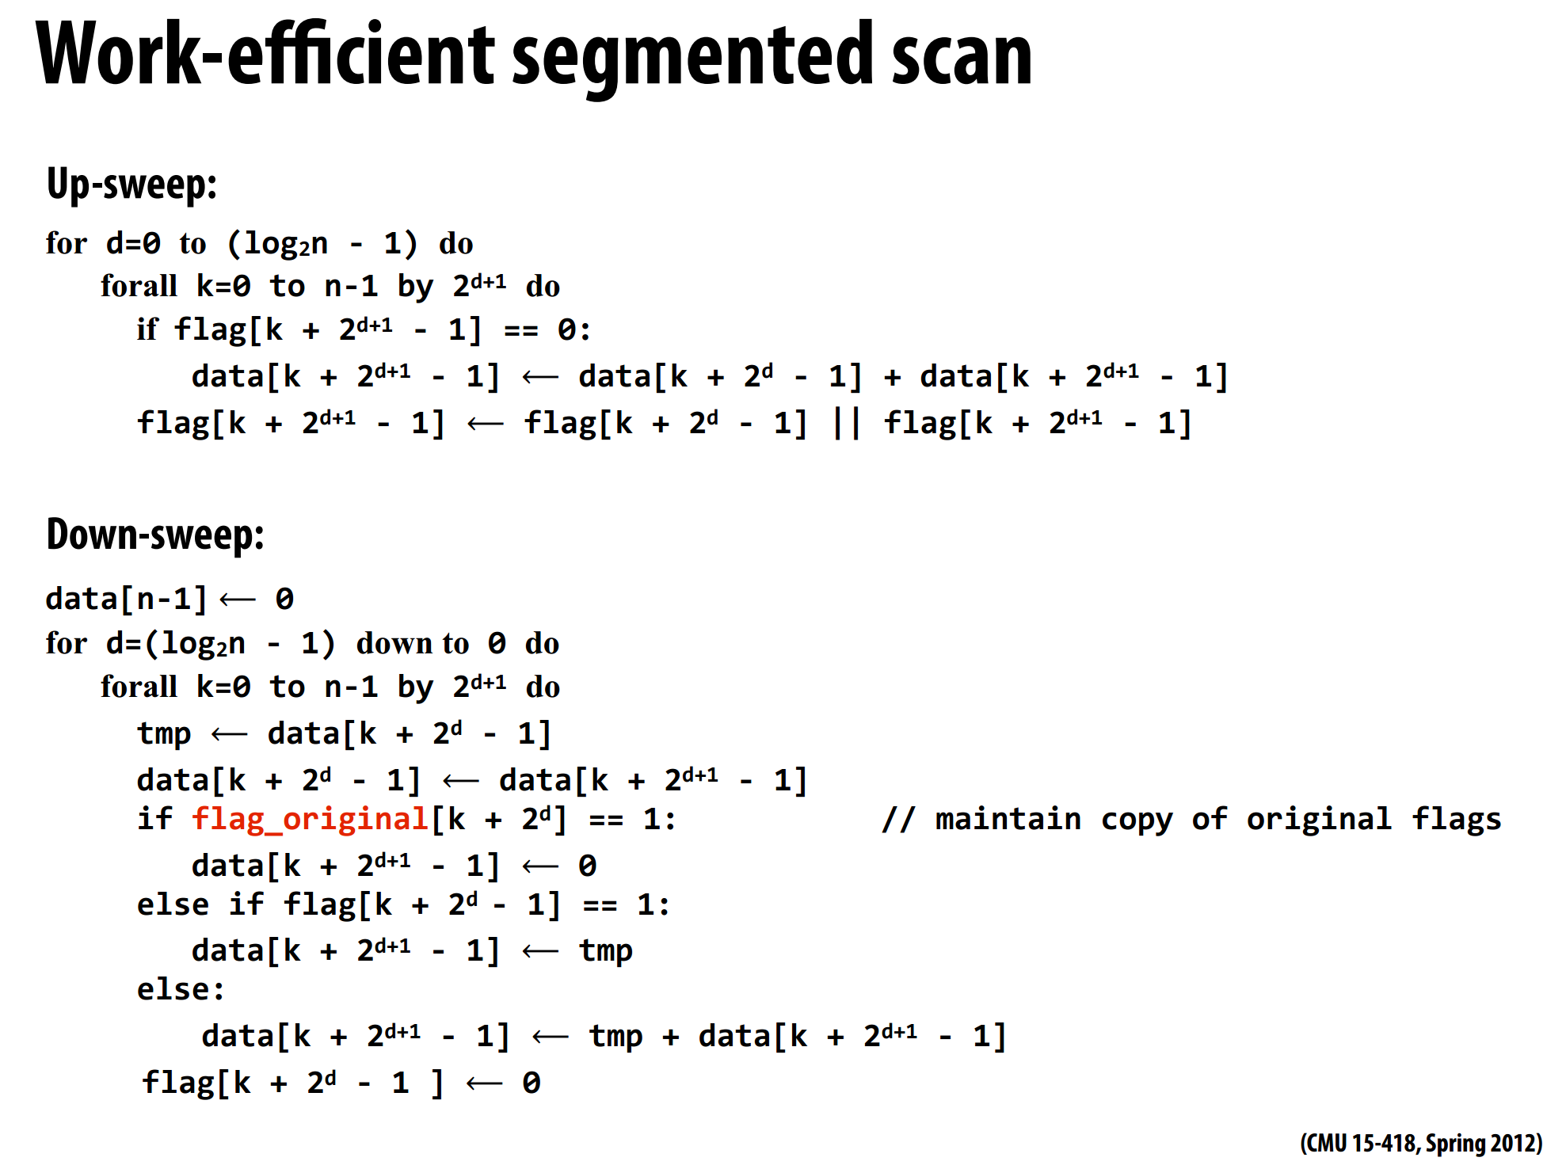
Segmented scan
flag_original is the array of flags marking the segments.
flags is a new array defined based on flags_original.
Follows the basic up / down sweep structure of normal scan.
Source: http://www.cs.cmu.edu/afs/cs/ academic/class/15418-s12/www/

Slide 16
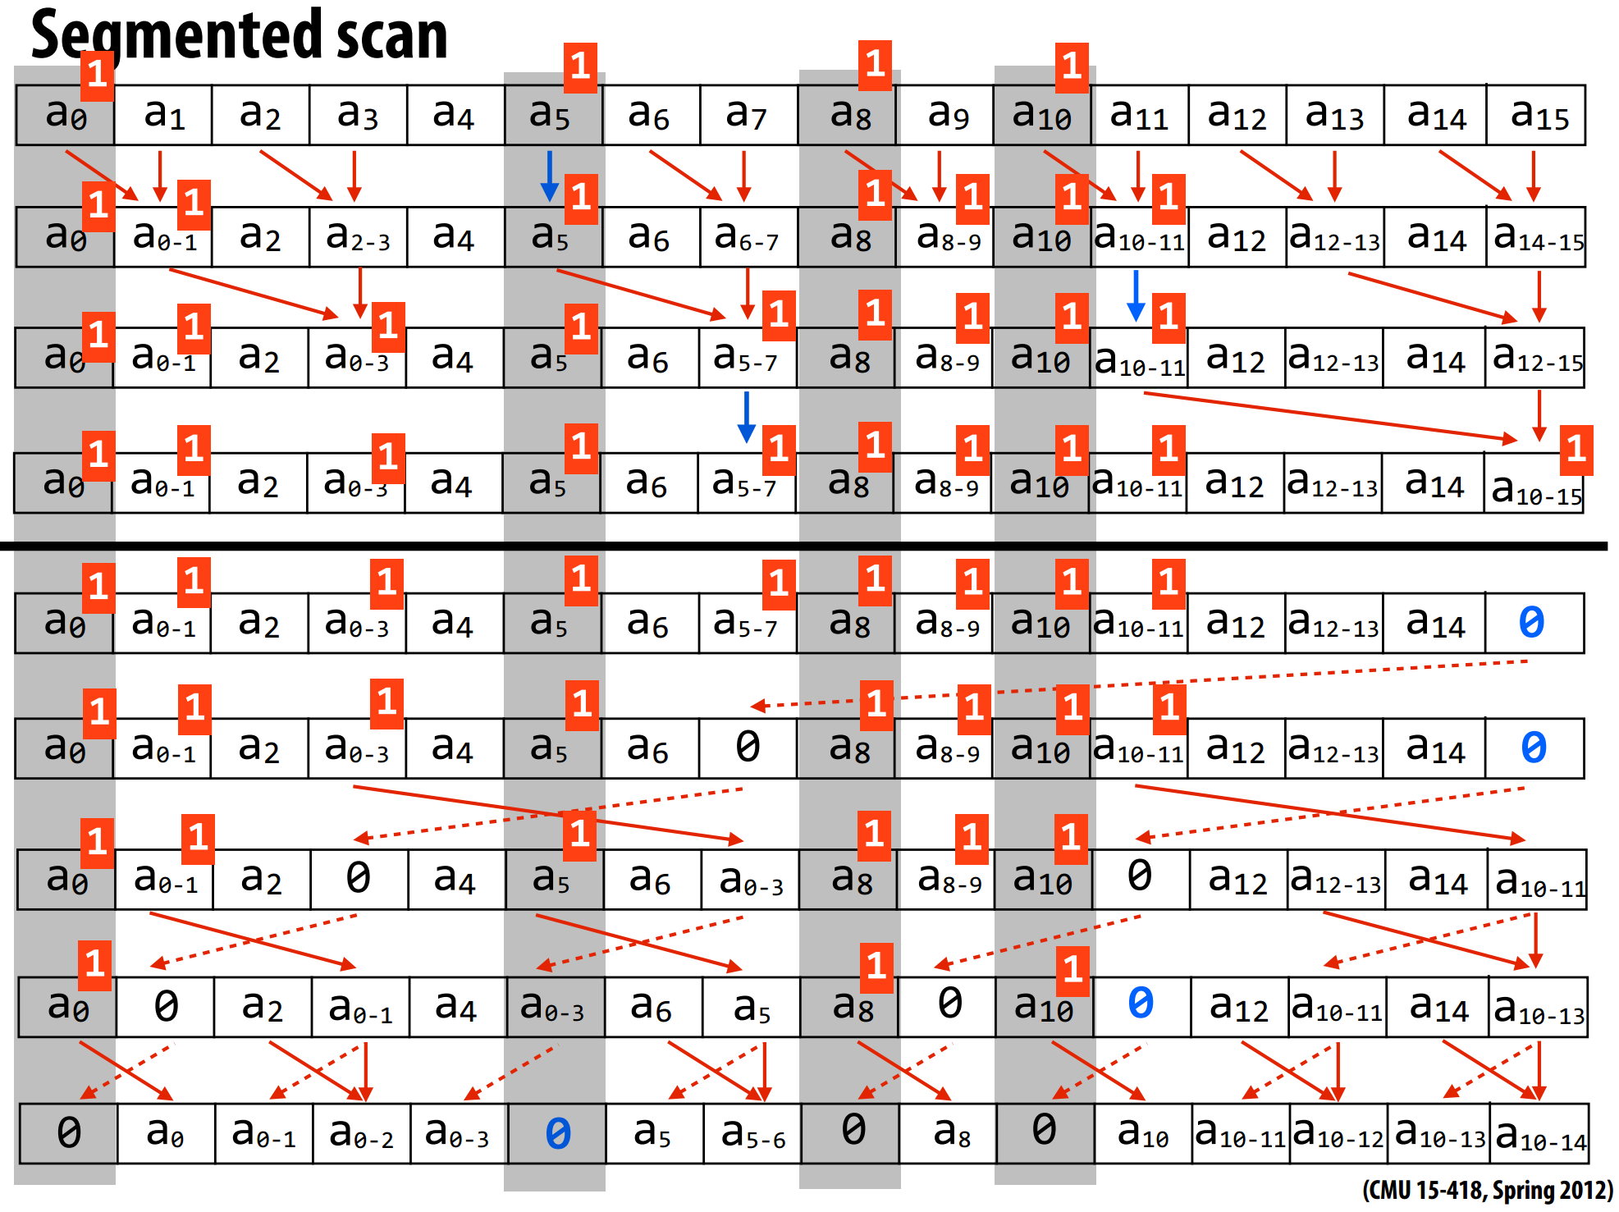

Slide 17
Application: compaction
Create array containing elements of input array satisfying a condition.
Ex Move all odd numbers in A to front of output.
Create filter array that’s 1 if element satisfies condition.
Prefix sum the filter array.
For each element, if it satisfies condition, move it to index given by prefix sum.
A = [1 3 2 4 8 6 5 4 9 7 3]
filter = [1 1 0 0 0 0 1 0 1 1 1]
sums = [1 2 2 2 2 2 3 3 4 5 6]
output = [1 3 5 9 7 3]

Slide 18
Application: string comparison
Compare two strings alphabetically.
Ex parallax < parallel.
Let strings be S, T. Let S[i],T[i] denote i’th letter of S,T.
In parallel, i’th processor compares S[i] to T[i].
If S[i]>T[i], set A[i]=1.
If S[i]=T[i], set A[i]=0.
If S[i]<T[i], set A[i]=-1.
If S[i] or T[i] doesn’t exist, set A[i]=0.
Compact A to remove all 0’s.
If output[1]=1, then S>T.
If output[1]=-1, then T>S.
If output is empty, then S=T.
Ex S=parallax, T=parallel, A=[0,0,0,0,0,0,-1,1], output=[-1,1], so T>S.

Slide 19
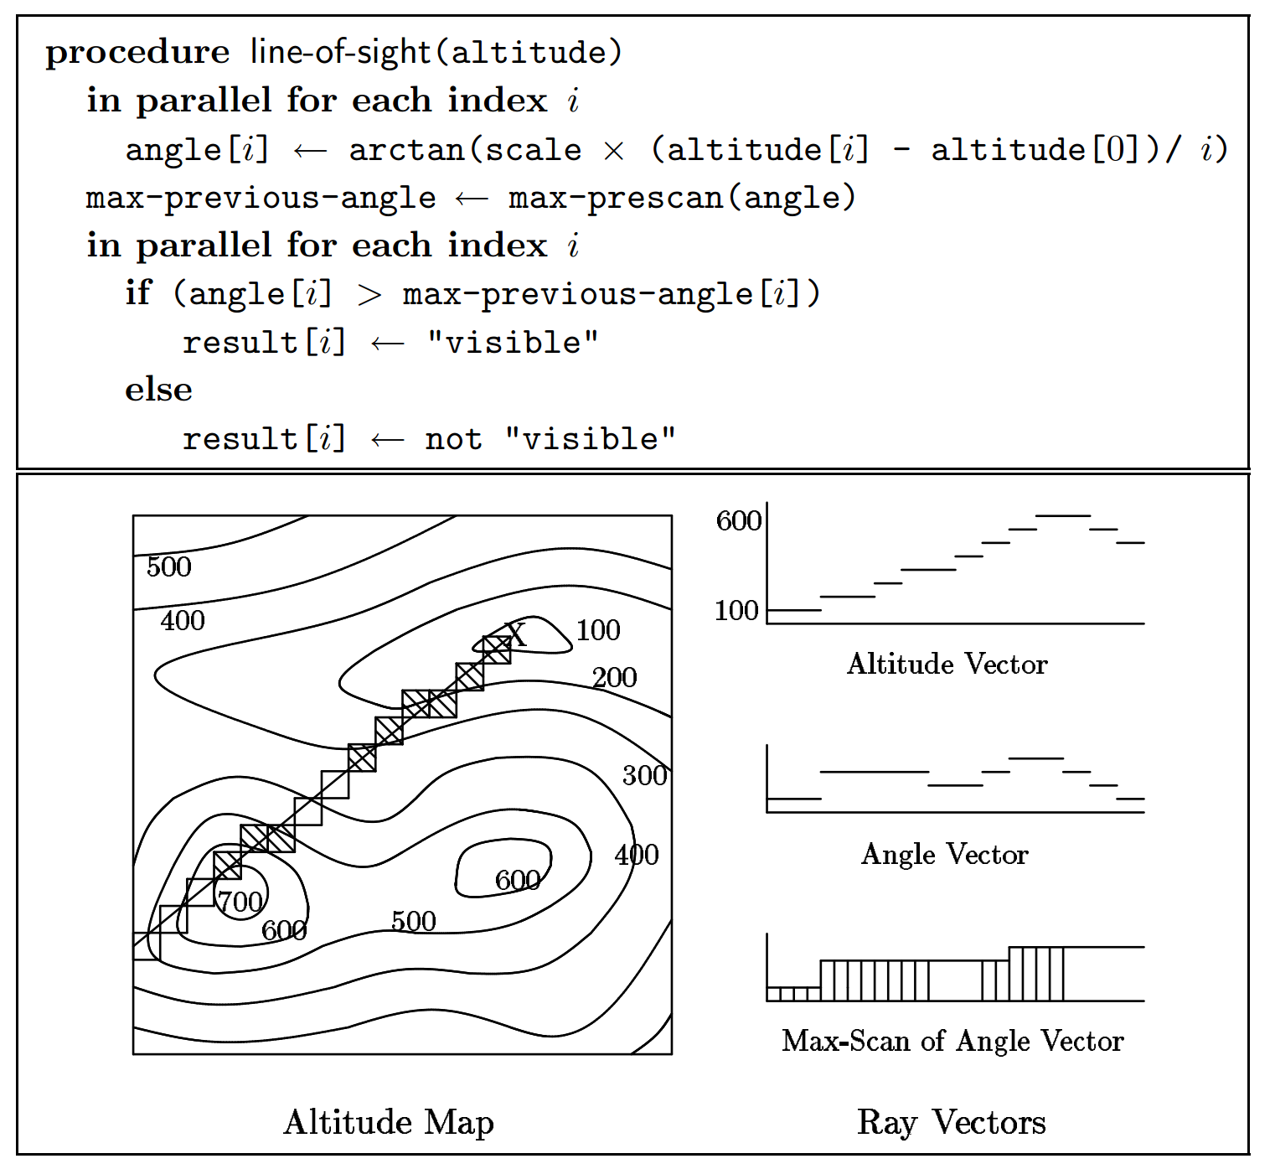
Application: line of sight
Given a contour map, an observation point X and a direction, want to know which points are visible.
First, draw a line from X in the observing direction and record the altitudes along the line in an altitude vector.
Then for each point calculate its angle, based on its altitude and distance from X.
Then do a max-scan over the angle vectors.
A point is visible iff its angle is larger than all the preceding angles.

